Slide 1
CS302 Operating System Lab 7 Synchronization
Xinxun Zeng

Slide 2
Deal with deadlock
• We can use a protocol to prevent or avoid deadlocks, ensuring that the system will never enter a deadlocked state.
• We can allow the system to enter a deadlocked state, detect it, and recover.
• We can ignore the problem altogether and pretend that deadlocks never occur in the system.

Slide 3
Other alternative way
Setting grab order
Odd number philosopher first take left and then right
Even number philosopher first take right and then left
Allow at most 4 philosopher take the left chopsticks at the same time
Add a semaphore to monitor this behavior

Slide 4
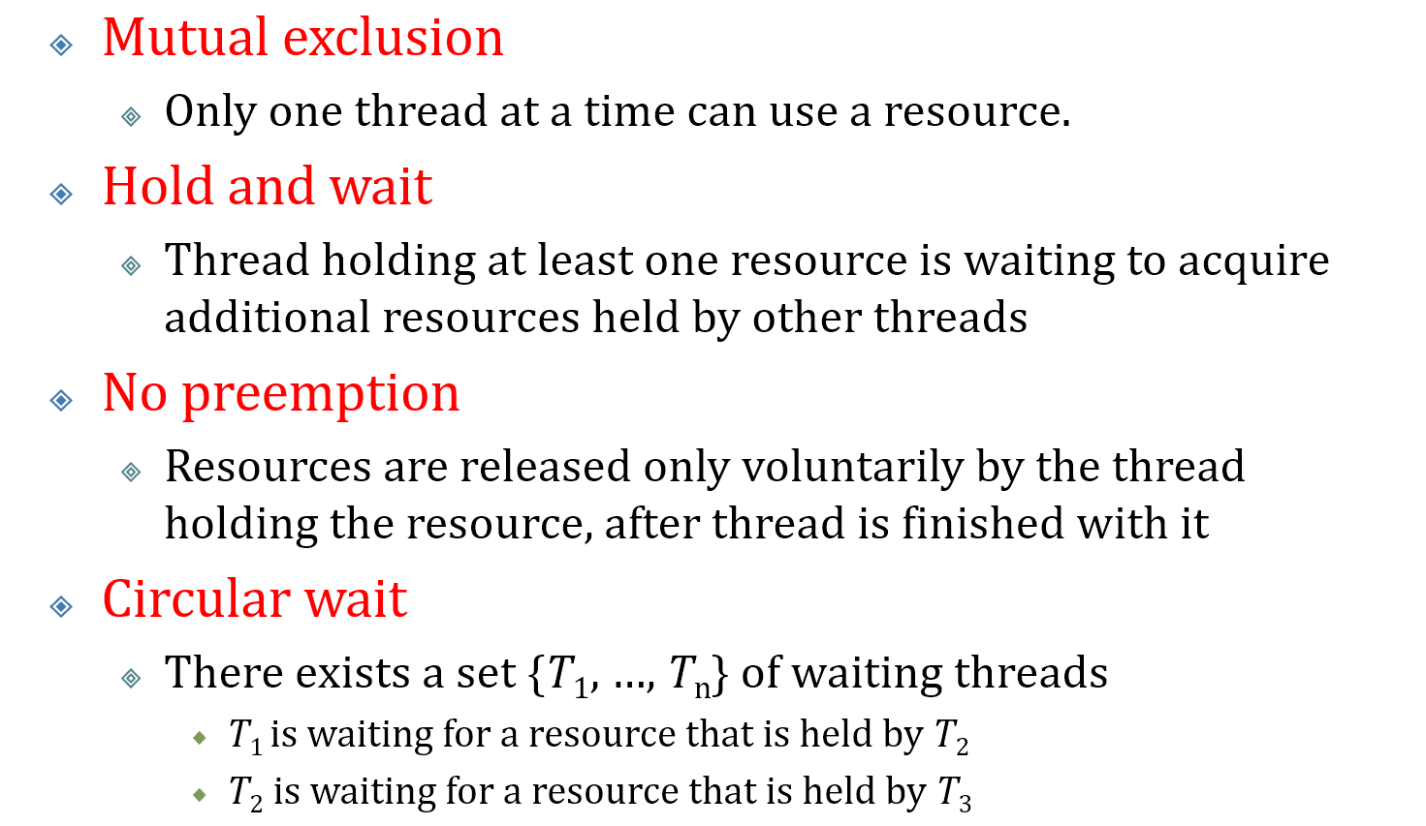
Deadlock Prevention
Break the one of the requirement of deadlock

Slide 5
Deadlock Avoidance
Resource-Allocation-Graph Algorithm
Banker’s Algorithm

Slide 6
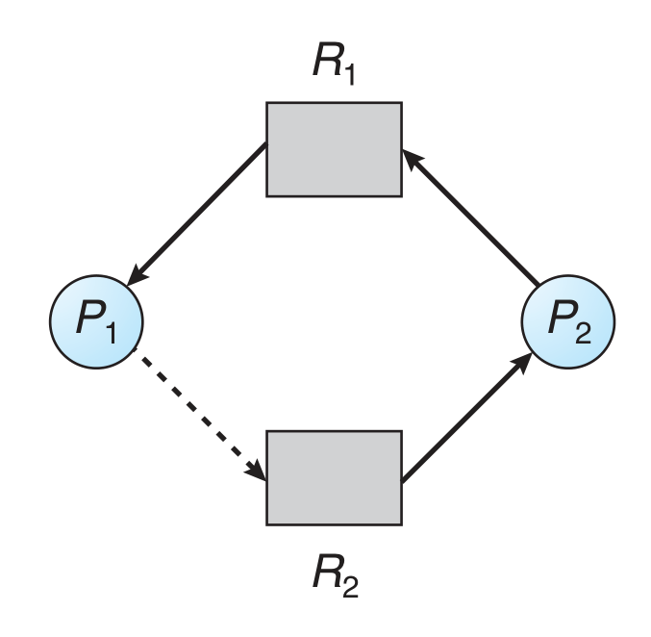
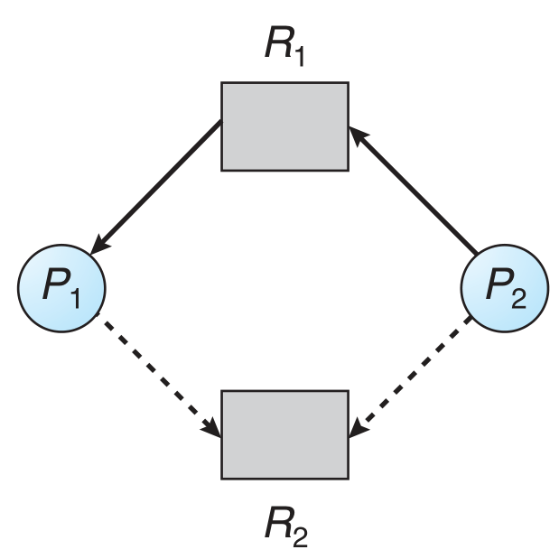
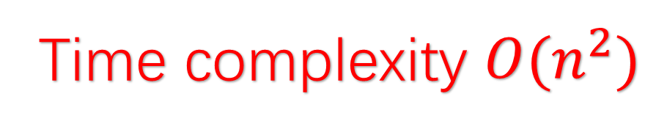
Resource-Allocation-Graph Algorithm
Unsafe
R1 assign to P1
P2 request R1
Safe
Deadlock
P2 may need R2
Time complexity $O(n^{2})$

Slide 7
Banker’s Algorithm
Safety Checking
Resource Requesting

Slide 8
Safe State
A state is safe if the system can allocate resources to each process (up to its maximum) in a safe sequence.
Assume we have 12 resources
Process | Maximum Need | Current Allocated
P1 | 10 | 0
P2 | 4 | 0
P3 | 9 | 0
Remain |  | 12
Process | Maximum Need | Current Allocated
P1 | 10 | 5
P2 | 4 | 2
P3 | 9 | 2
Remain |  | 3
Process | Maximum Need | Current Allocated
P1 | 10 | 5
P2 | 4 | 2
P3 | 9 | 4
Remain |  | 2
Safe
Safe
Unsafe

Slide 9
Safe State (more example)
Process | Maximum Need | Current Allocated
P1 | 10 | 3
P2 | 4 | 0
P3 | 9 | 5
Remain |  | 4
Process | Maximum Need | Current Allocated
P1 | 10 | 6
P2 | 4 | 4
P3 | 9 | 2
Remain |  | 0
Process | Maximum Need | Current Allocated
P1 | 10 | 4
P2 | 4 | 4
P3 | 9 | 4
Remain |  | 0
Safe
Safe
Unsafe

Slide 10
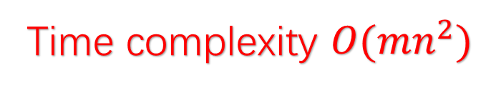
Safety Checking
 | Max |  |  | Allocation |  |  | Need
 | A | B | C | A | B | C | A | B | C
P1 | 7 | 5 | 3 | 0 | 1 | 0 | 7 | 4 | 3
P2 | 3 | 2 | 2 | 2 | 0 | 0 | 1 | 2 | 2
P3 | 9 | 0 | 2 | 3 | 0 | 2 | 6 | 0 | 0
P4 | 2 | 2 | 2 | 2 | 1 | 1 | 0 | 1 | 1
P5 | 4 | 3 | 3 | 0 | 0 | 2 | 4 | 3 | 1
Remain |  |  |  | 3 | 3 | 2
Safe
P2, P4, P1, P3, P5
Time complexity $O({mn}^{2})$

Slide 11
Resource Requesting
 | Max |  |  | Allocation |  |  | Need
 | A | B | C | A | B | C | A | B | C
P1 | 7 | 5 | 3 | 0 | 1 | 0 | 7 | 4 | 3
P2 | 3 | 2 | 2 | 2 | 0 | 0 | 1 | 2 | 2
P3 | 9 | 0 | 2 | 3 | 0 | 2 | 6 | 0 | 0
P4 | 2 | 2 | 2 | 2 | 1 | 1 | 0 | 1 | 1
P5 | 4 | 3 | 3 | 0 | 0 | 2 | 4 | 3 | 1
Remain |  |  |  | 3 | 3 | 2
New request: P2 (1,0,2)
<Remain?
<Max(P2)?

Slide 12
Resource Requesting
 | Max |  |  | Allocation |  |  | Need
 | A | B | C | A | B | C | A | B | C
P1 | 7 | 5 | 3 | 0 | 1 | 0 | 7 | 4 | 3
P2 | 3 | 2 | 2 | 3 | 0 | 2 | 0 | 2 | 0
P3 | 9 | 0 | 2 | 3 | 0 | 2 | 6 | 0 | 0
P4 | 2 | 2 | 2 | 2 | 1 | 1 | 0 | 1 | 1
P5 | 4 | 3 | 3 | 0 | 0 | 2 | 4 | 3 | 1
Remain |  |  |  | 2 | 3 | 0
New request: P2 (1,0,2)
<Remain?
<Max(P2)?
Try assign resource for P2
Still safe?
Safe!

Slide 13
Resource Requesting
 | Max |  |  | Allocation |  |  | Need
 | A | B | C | A | B | C | A | B | C
P1 | 7 | 5 | 3 | 0 | 1 | 0 | 7 | 4 | 3
P2 | 3 | 2 | 2 | 2 | 0 | 0 | 1 | 2 | 2
P3 | 9 | 0 | 2 | 3 | 0 | 2 | 6 | 0 | 0
P4 | 2 | 2 | 2 | 2 | 1 | 1 | 0 | 1 | 1
P5 | 4 | 3 | 3 | 0 | 0 | 2 | 4 | 3 | 1
Remain |  |  |  | 3 | 3 | 2
New request: P2 (2,0,2)
<Max(P2)? ×
New request: P5 (4,0,0)
<Remain? ×
New request: P1 (3,3,2)
Still safe? ×

Slide 14
Dining Philosophers with Banker’s Algorithm
 | Max |  |  | Allocation |  |  | Need
 | C1 | C2 | C3 | C1 | C2 | C3 | C1 | C2 | C3
P1 | 1 | 1 | 0 | 0 | 0 | 0 | 1 | 1 | 0
P2 | 0 | 1 | 1 | 0 | 0 | 0 | 0 | 1 | 1
P3 | 1 | 0 | 1 | 0 | 0 | 0 | 1 | 0 | 1
Remain |  |  |  | 1 | 1 | 1

Slide 15
Assignment: Banker’s Algorithm
You are asked to implement a Banker’s Algorithm, your code will be judged by standard test case.
language: C++, you are free to use all STL
Input:
First line is an integer r, which is the number of resource types.
The second line will be r integers, which are the maximum quantity of each resource.
Then will be following a list of commands. The commands are in three form:
New process registering, such as “1678 new 6 5 0 7”, means process 1678 is a new process, whose maximum need of each resource is 6 5 0 7 (assume r is 4)
Resource requesting, such as “233 request 0 4 5 3”, means process 233 is an old process, it request more resource, the need of each resource is 0 4 5 3.
Process termination, such as “233 terminate”, means process 233 terminate and return all resources it holding.
Output:
For each command, output “OK” or “NOT OK” to determine if the command can execute. If OK, execute the command.

Slide 16
Assignment Sample
input:
3
4 2 3
233 new 1 2 3
888 new 4 3 3
777 new 4 2 3
233 request 1 2 0
777 request 0 0 4
777 request 0 0 3
233 terminate
output:
OK
NOT OK
OK
OK
NOT OK
NOT OK
OK

